Slide 1
SOLID Principles
Presented by Rutuja Pimpalgaonkar

Slide 2
Contents
What is SOLID
Single responsibility Principle
Open/Closed Principle
Liskov Substitution Principle
Interface Segregation Principle
Dependency Inversion Principle

Slide 3
What is SOLID?
S
SRP
Single
Responsibility
Principle
O
OCP
Open/Closed
Principle
L
LSP
Liskovs
Substitution
Principle
I
ISP
Interface
Segregation
Principle
D
DIP
Dependency
Inversion
Principle

Slide 4
Single Responsibility Principle
“A class should have one and
only one reason to change”

Slide 5
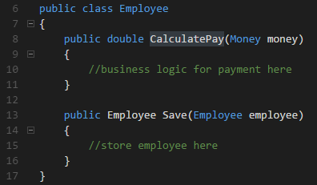

Single Responsibility Principle
Business logic
Persistence
There are two responsibilities

Slide 6

Single Responsibility Principle
How to solve this?

Slide 7
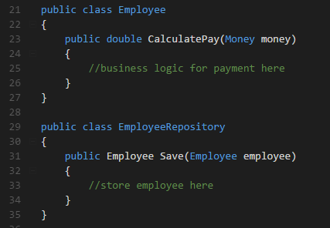

Single Responsibility Principle
Just create two different classes

Slide 8
Open/Closed Principle
“Software entities should be open for extension, but closed for modification.”

Slide 9
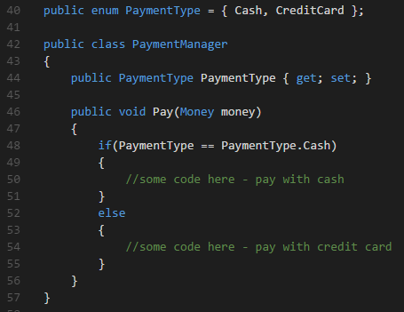
Open/Closed Principle
Humm...and if I need to add a new payment type?
You need to modificate this class.

Slide 10
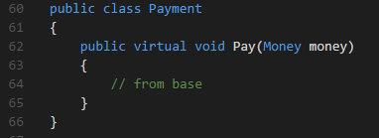
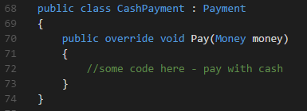
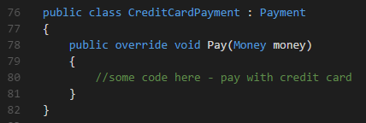
Open/Closed Principle
open for extension
close for modification

Slide 11

Liskov Substitution Principle
“Let q(x) be a property provable about objects x of type T. Then q(y) should be provable for objects y of type S where S is a subtype of T”
What do you say?

Slide 12
Liskov Substitution Principle
“A subclass should behave in such a way that it will not cause problems when used instead of the superclass.”

Slide 13
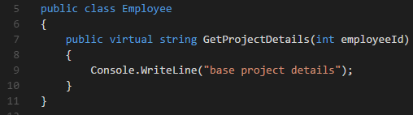
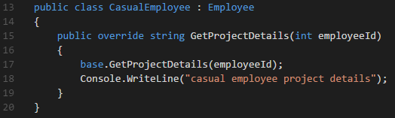
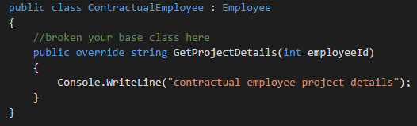

Liskov Substitution Principle

Slide 14
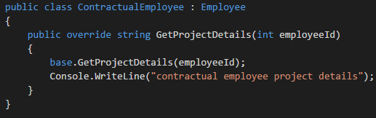

Liskov Substitution Principle
Much better

Slide 15
Interface Segregation Principle
“Clients should not be forced to depend upon interfaces that they don't use”

Slide 16
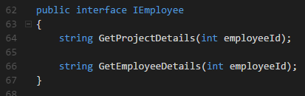
Interface Segregation Principle

Slide 17
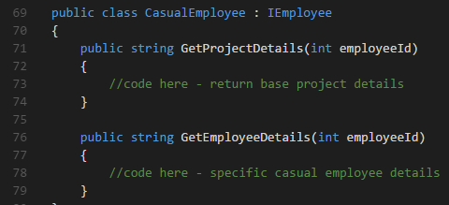
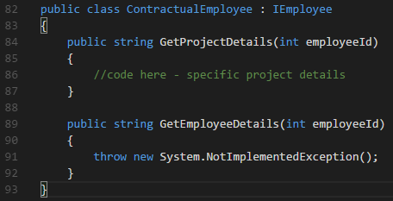

Interface Segregation Principle
WHY?????
I don’t need you!!

Slide 18
Interface Segregation Principle
How to solve this?

Slide 19


Interface Segregation Principle
You need to create two interfaces

Slide 20
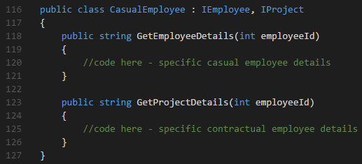
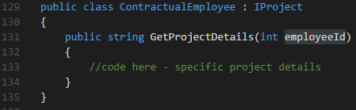
Interface Segregation Principle

Slide 21
Dependency Inversion Principle
“High-level modules should not depend on low-level modules. Both should depend on abstractions.”
“Abstractions should not depend upon details. Details should depend upon abstractions.”

Slide 22
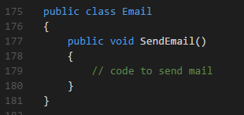
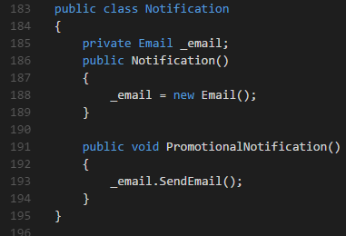
Dependency Inversion Principle
And if I need to send a notification by SMS?
You need to change this.

Slide 23

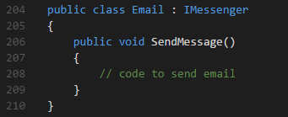
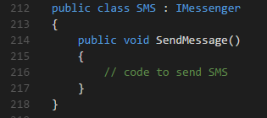
Dependency Inversion Principle
So, I create an interface and now?

Slide 24
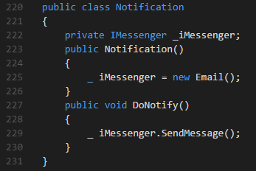
Dependency Inversion Principle

Slide 25
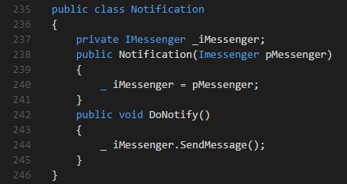
Dependency Inversion Principle
Constructor injection:

Slide 26
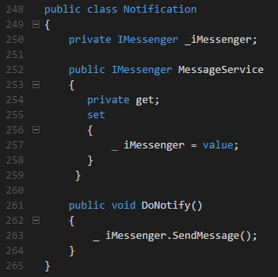
Dependency Inversion Principle
Property injection:

Slide 27
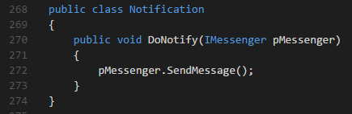
Dependency Inversion Principle
Method injection:

Slide 28
Enjoy code and
Keep it simple!

Slide 29

Thank you

